Slide 1
MUSIC STORE DATABASE
FINAL PROJECT PRESENTATION

Slide 2
PRESENTED BY
Biozid Rahman Niloy
Azool hirani

Slide 3
SPECIFC SCENARIO
More Dynamic
New Elements
Procedural response

Slide 4
THE E.E.R MODEL

Slide 5
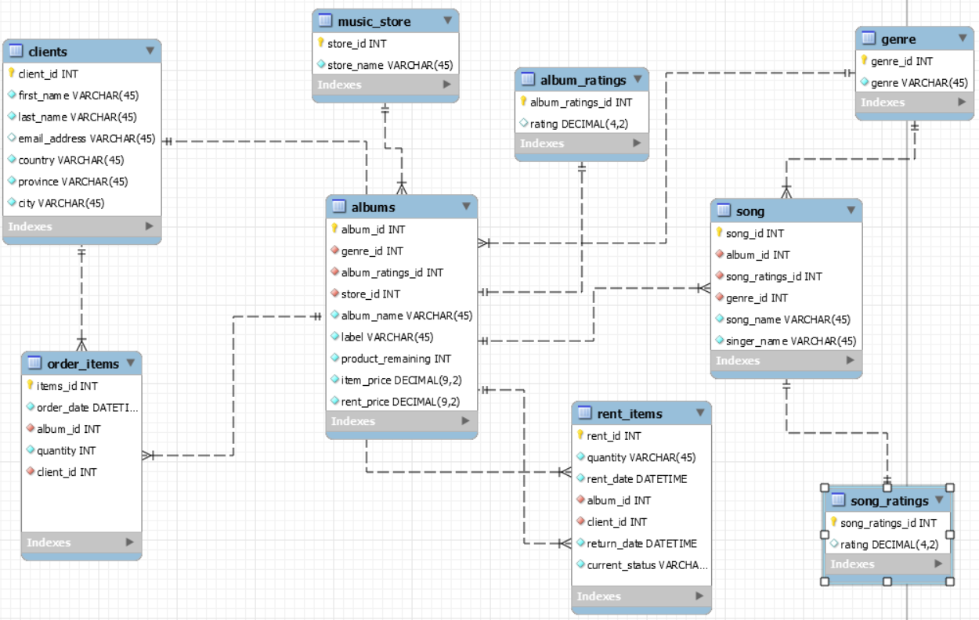

Slide 6
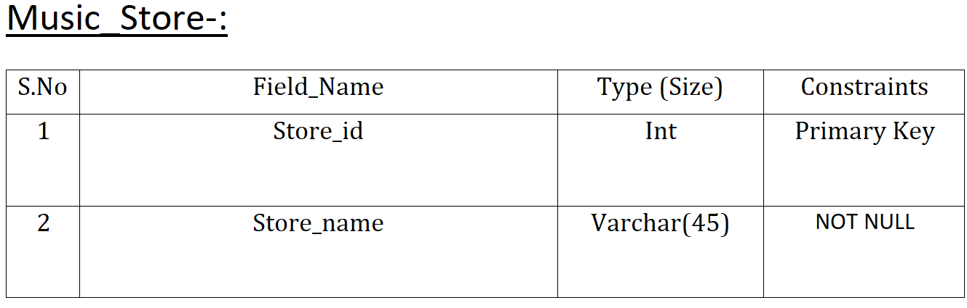
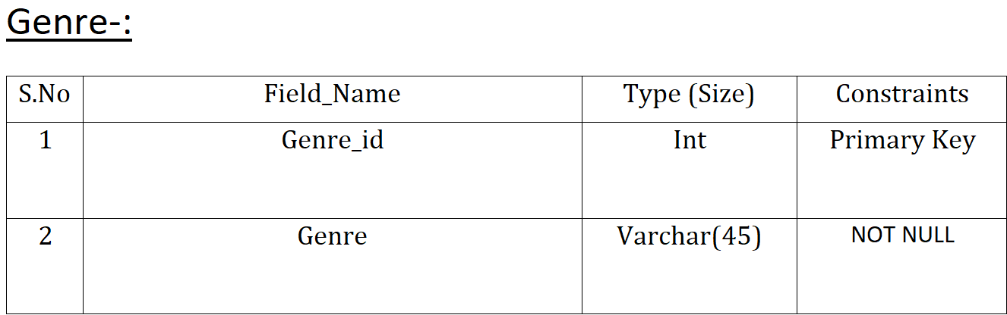
THE TABLES

Slide 7
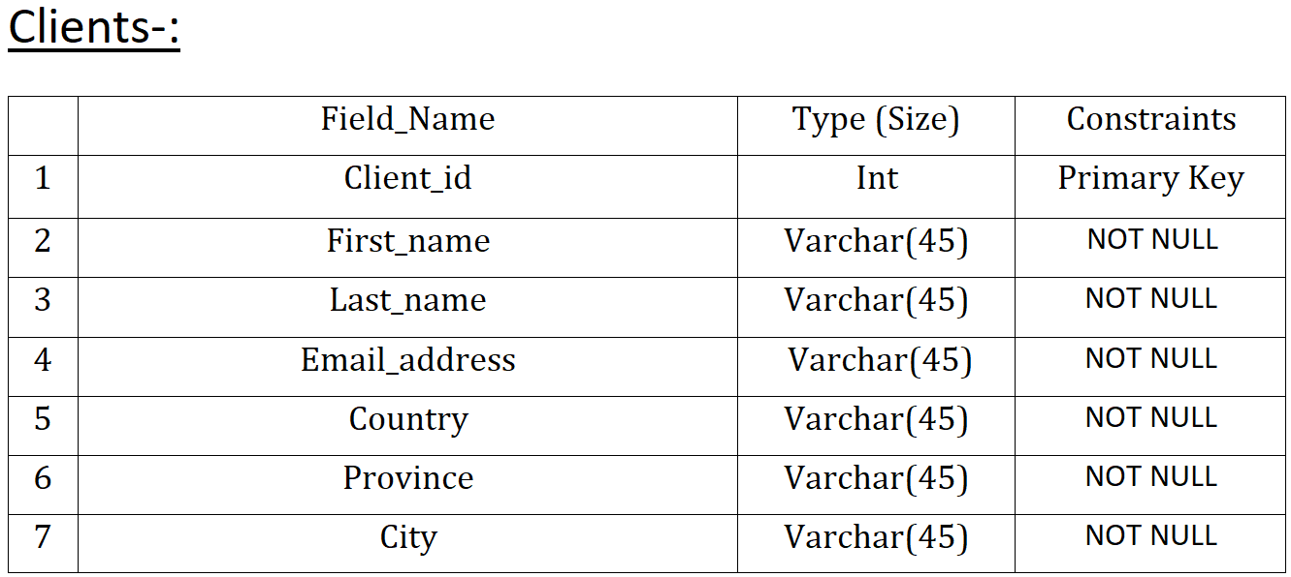
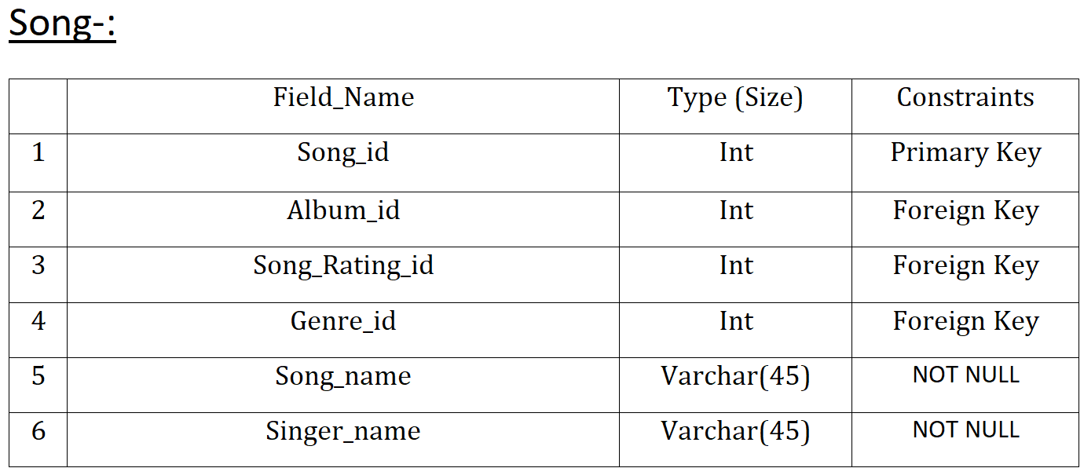
THE TABLES

Slide 8
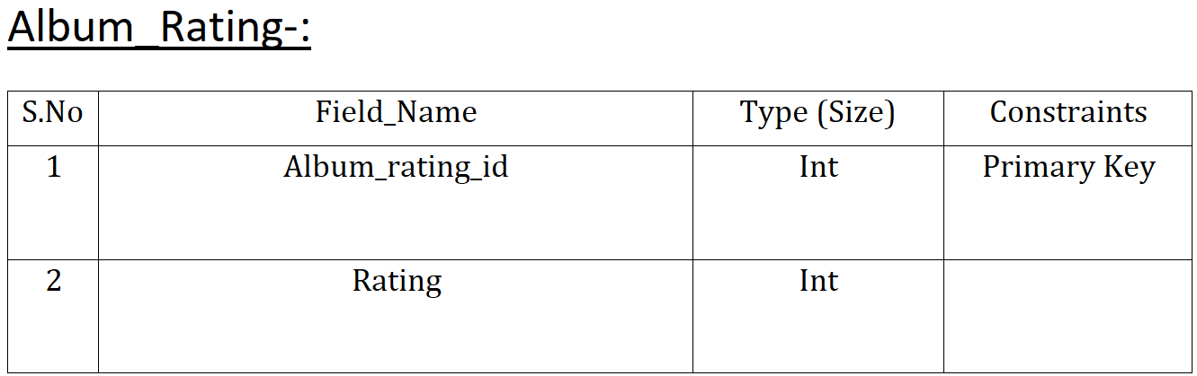
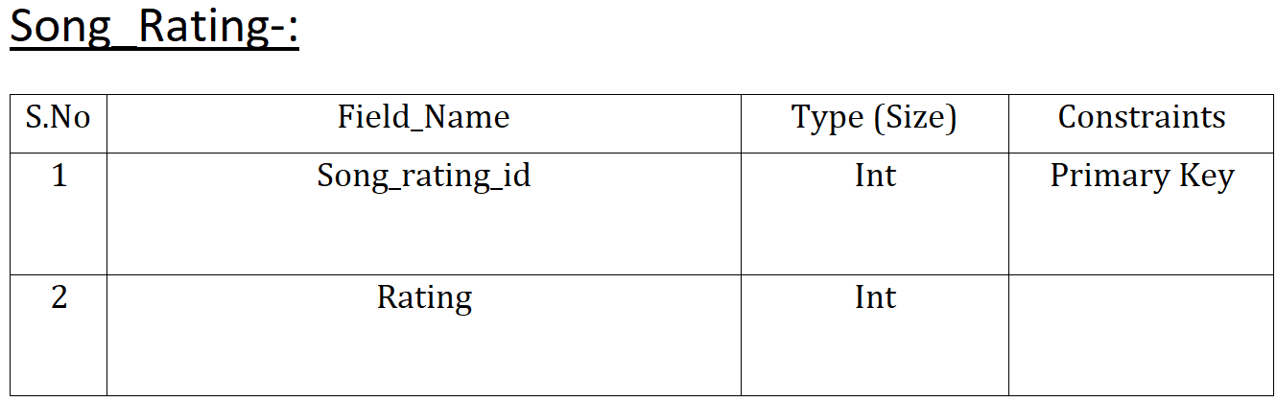
THE TABLES

Slide 9
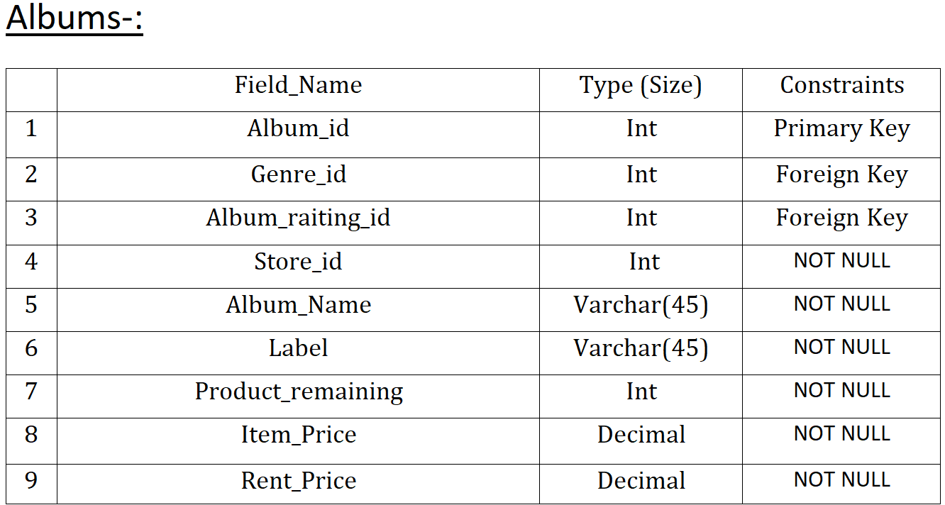
THE TABLES

Slide 10
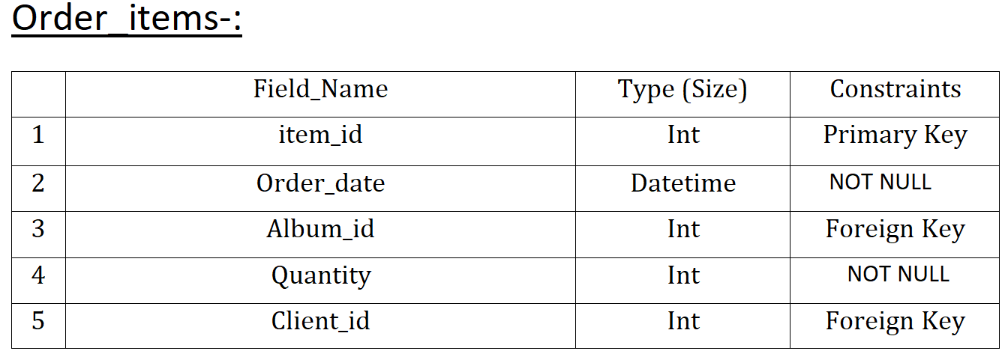
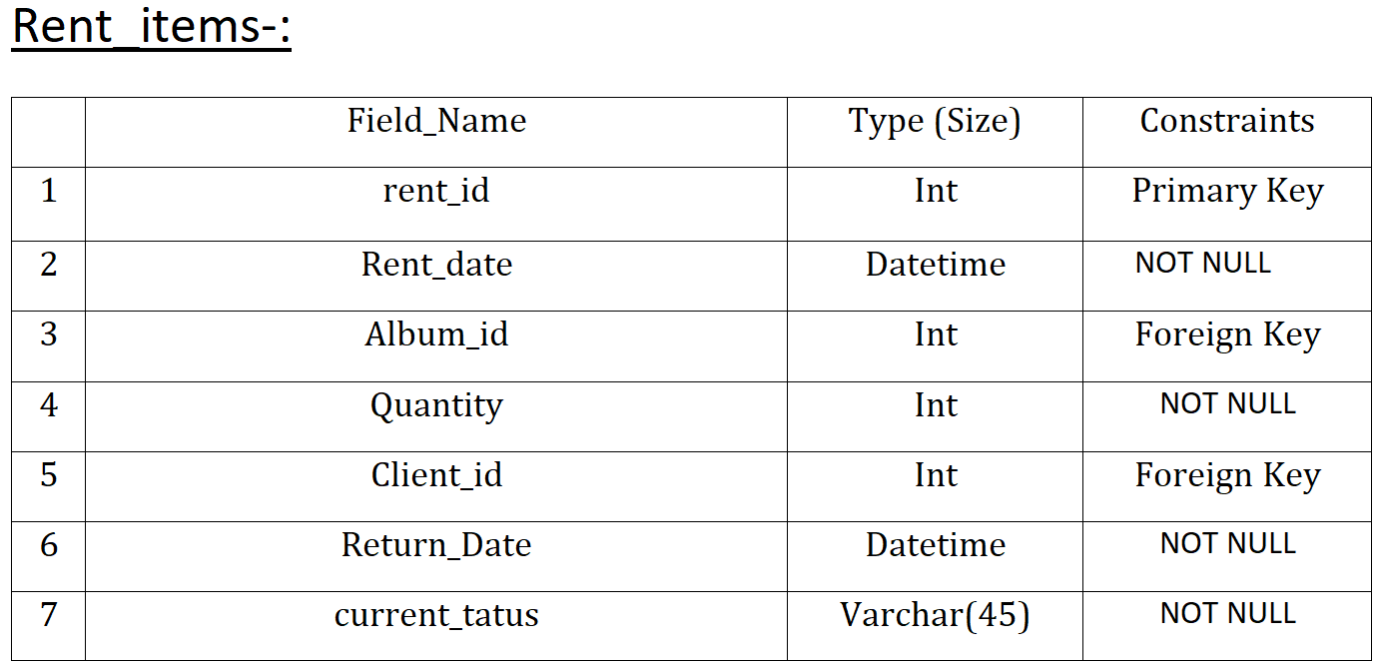
THE TABLES

Slide 11
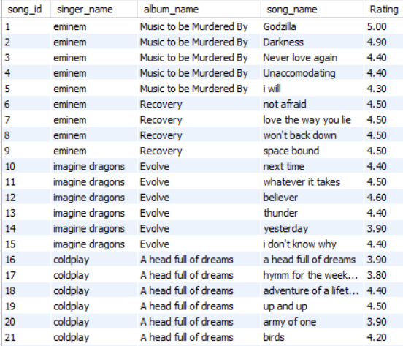
VIEWS (NON_UPDATABLE

Slide 12
STORED PROCEDURE AND EVENTS
event_restocking
procedure_rent_expiry
procedure_return_rented

Slide 13
TRIGGERS
trigger_new_client_order_items
trigger_new_client_rent_items
trigger_product_remaining
trigger_rent_product_remaining

Slide 14
DEMONSTRATION

